Slide 1



Lists & Dictionaries
Powerful and flexible data containers in Python
Notes:
Thie video will provide a brief introduction to lists and dictionaries in python. They have many similarities and differences, but notably, they are both flexible and powerful data containers in python. While they can be used on their own, they are often used in conjunction with arrays and dataframes, so understanding the fundamentals of how to work with and modify them is an important foundational skill for anyone doing machine learning work in python.
Lists and Dictionaries are flexible containers for data in python. They can be used on their own, but are often also used in conjuncion with arrays and dataframes. Understanding how to use and modify lists and dictionaries will make up an important foundation for future projects in this field.

Slide 2


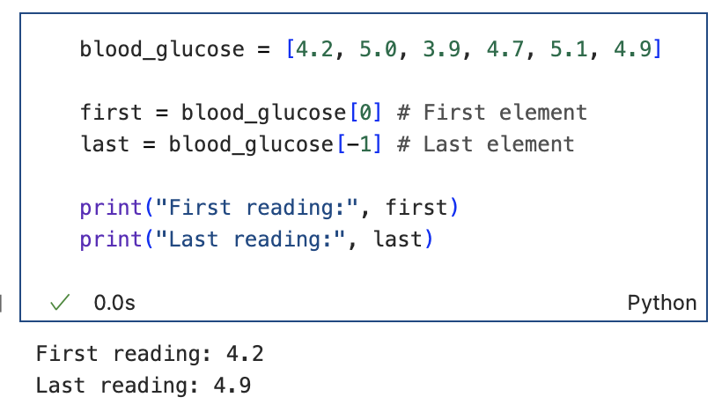
Lists: indexing
Notes:
We will start with lists
A single component of a list is called an element
Indexing starts at 0 and not 1 in python., and to find the first element, you write the list’s name followed by the index of the element you would like to look up. In the first example…
In the second example…

Slide 3

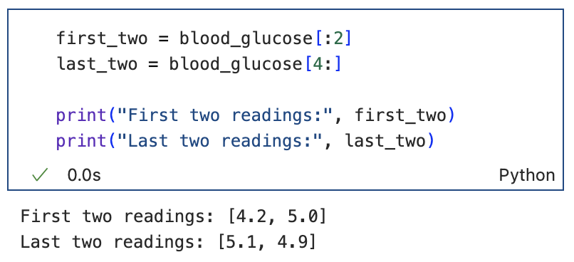
Lists: slicing
[start:stop]
Notes:
Slicing builds on the features of indexing, but allows you to pull several elements of a list at once and create a smaller sub-list or slice. We use 2 values, separated by a colon, the first is the index of the first element you would like to include (where you start indexing), and the second is the index of the final element of your slice (where you stop indexing). Importantly, the start index is included in the slice and the stop index is excluded. If you don’t put any value in the start or stop position, the slice will begin at the beginning or end of the list

Slide 4
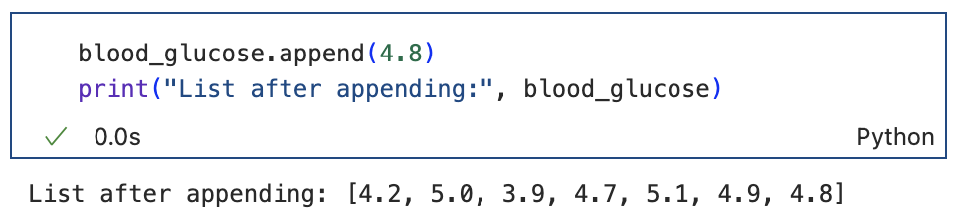
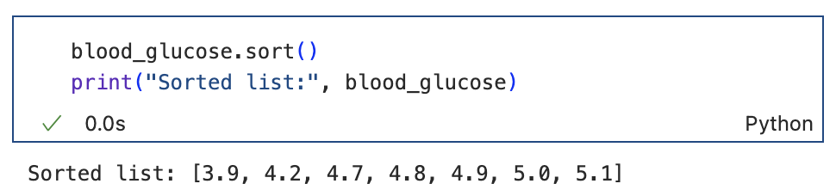
Lists: append & sort
Notes:
You might remember that a key feature of lists is their mutability – we can change the values and orders in a list. Here are two simple examples:

Slide 5
Dictionaries
Key
Value
Notes:
Dictionaries have some similarities and some differences to lists. While they are both sequential data types, finding a value in a list requires that you have its index, whereas finding a value in a dictionary requires that you have a key

Slide 6
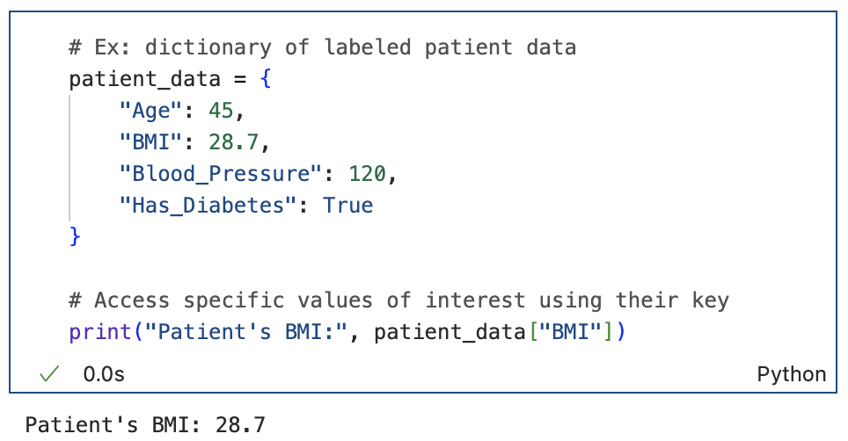
Dictionary use cases:
Data Organisation

Slide 7
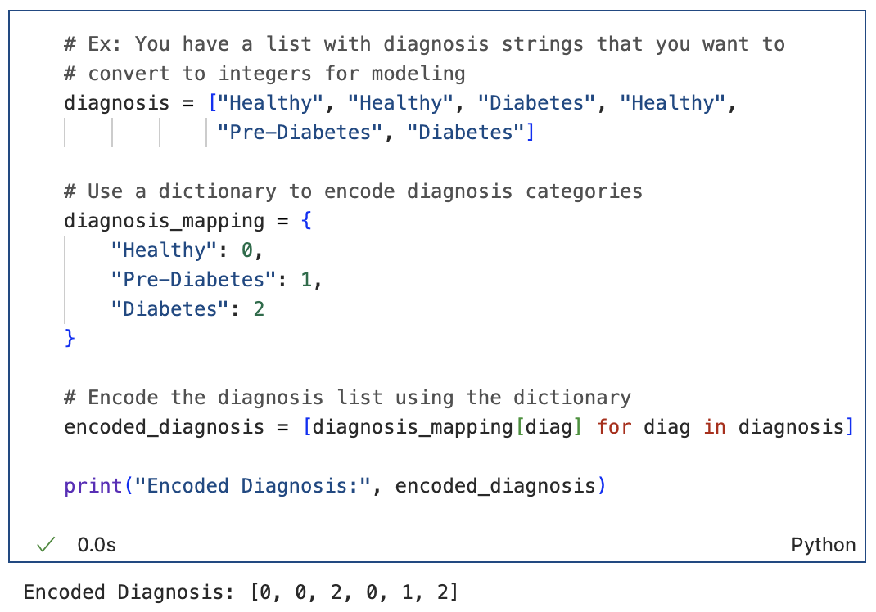
Dictionary use cases:
Label Encoding
We will discuss for loops in a future video, no need to understand this completely now.

Slide 8
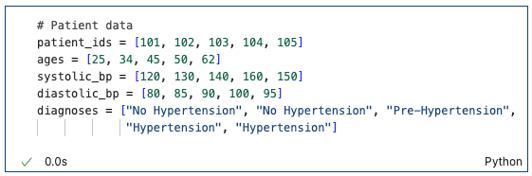
Challenge Yourself
Find the second element in the patient_ids list
Find the second last element in the patient_ids list
Create a new list with only the second, third, and fourth patient IDs in it
Add a new patient ID (106)
Sort the diastolic_bp list
Create a dictionary with patient 101's information.
If you were to use a dictionary to label encode the values in the diagnosis list, what would the dictionary look like?

Slide 9
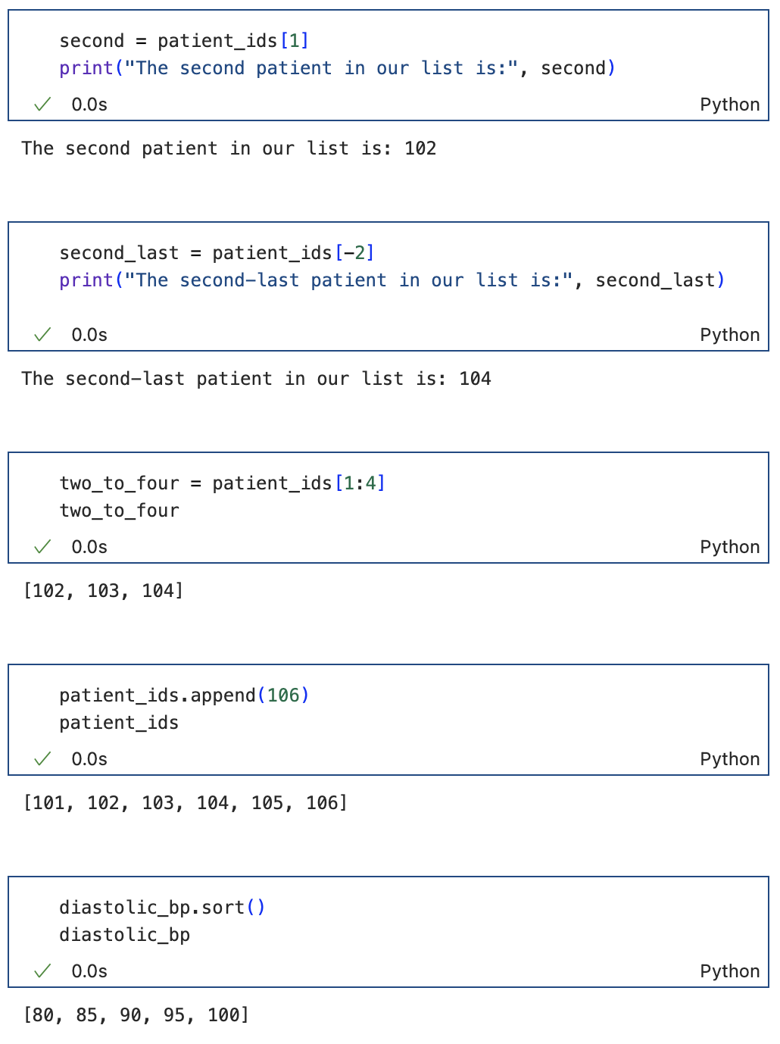


Slide 10
